Slide 1

UAV Planning, Autonomous Tracking, and Obstacle Identification and Avoidance
Álvaro Melgosa Pascual
1
Notes:
UAV=Unmanned Aerial Vehicle

Slide 2

Motivation
Notes:
First of all, why am I doing this?
What is the purpose of this Thesis?

Slide 3
Motivation
Safety
Notes:
Most important issue in aerospace industry
UAVs can be considered part of aerospace industry, but not so safe
Disembarking the human eliminates intuitive sensing (inertial, visual, noise…)
Sensing has to be done by sensors and interpreted by computers for safe autonomous flight

Slide 4
Safety
Motivation
Improved
OCAS
Notes:
OCAS (similarly to TCAS in commercial aircraft) tries to eliminate the posibility of a physical collision of the UAV with its surroundings
OCAS operates as intermediate functional layer between operator and UAV

Slide 5
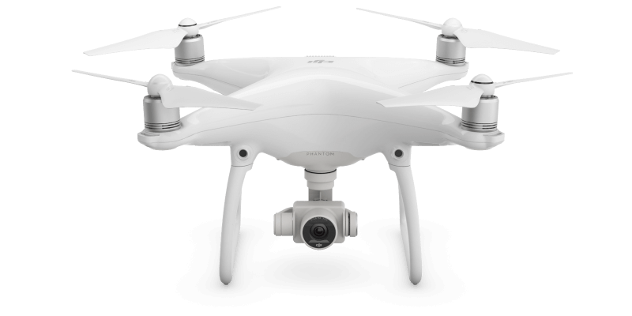
Example: DJI Phantom 4
Motivation
Source: dji.com
Notes:
Why is it important to have a reliable Obstacle Collision Avoidance System?
DJI recently (March 2016) built one into their Phantom 4
Based on stereoscopic cameras

Slide 6
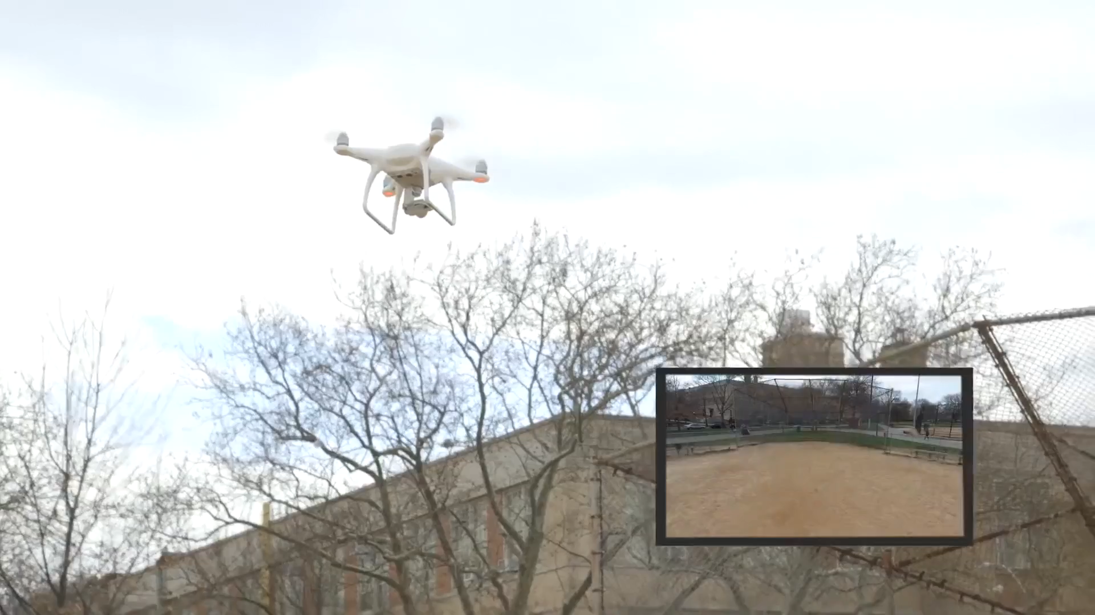
Regular operation
Motivation
Source: gizmodo.com
Notes:
Gizmodo journalists were testing the new features of the UAV
In particular the Emergency mode, that stops the vehicle when a collision is about to happen

Slide 7
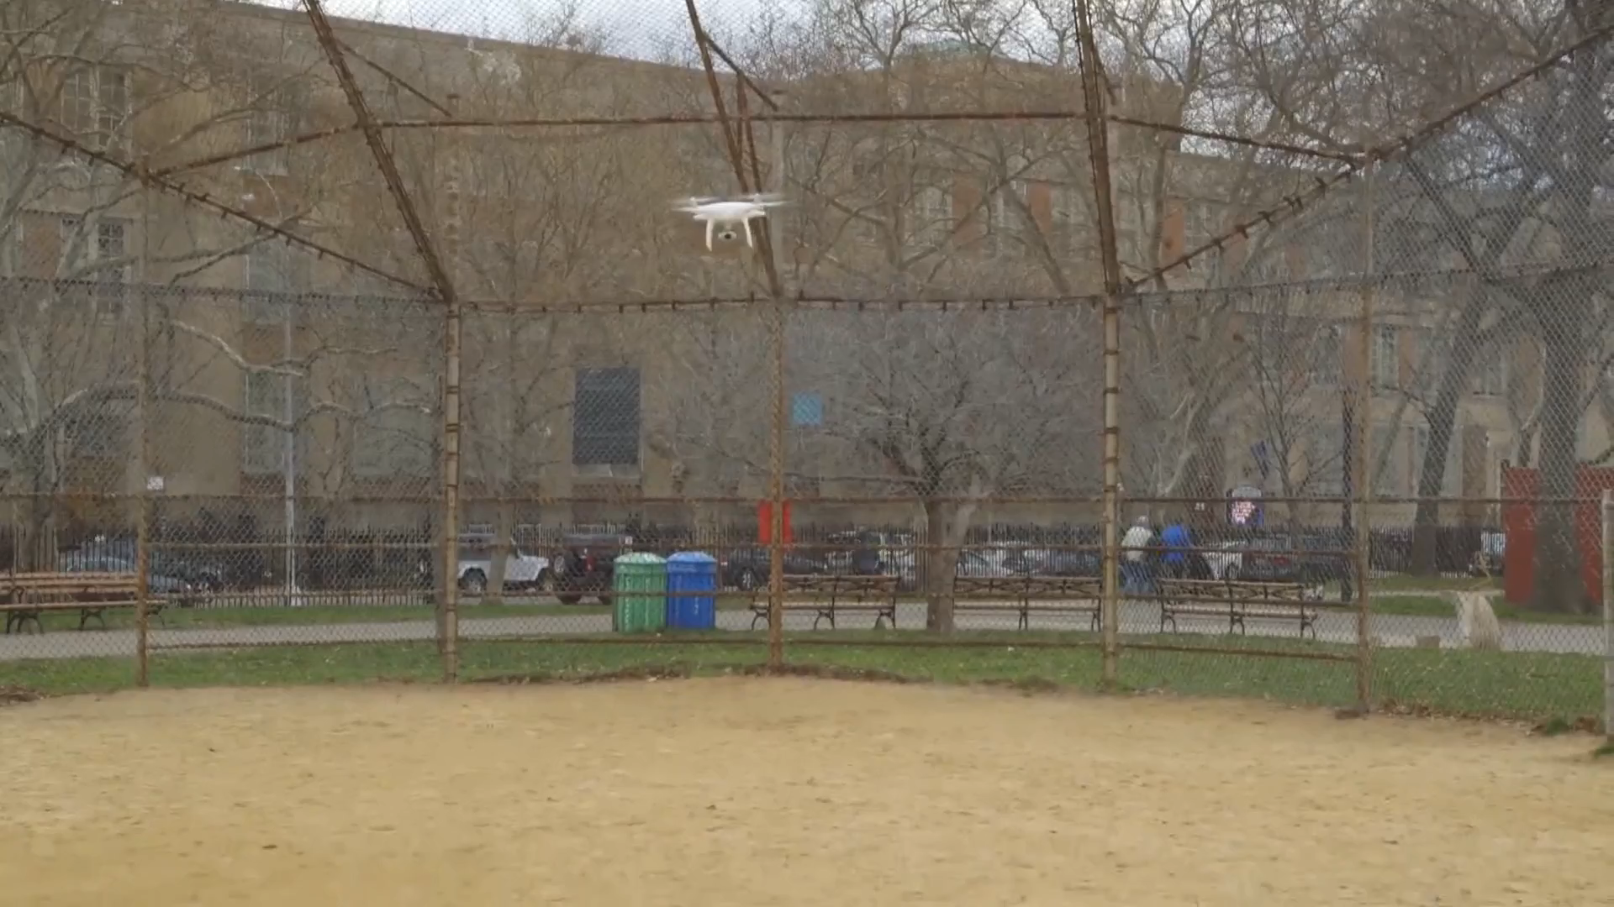
Faulty operation
Motivation
Source: gizmodo.com
Notes:
However, there are sometimes (Sport mode) that the Emergency mode is deactivated
The journalist was relying on that safety system while testing other features, and accidentally crashed the UAV

Slide 8
Problem statement
Motivation
Is it possible to improve the operational safety of a wide range of UAVs by developing an intermediate functional layer that prevents physical collisions between the UAV and its surroundings?
Notes:
Explanation from the Thesis

Slide 9
Objectives
Motivation
Design an OCAS
Integrate is within existing UAVs
Build a working prototype
Demonstrate that safety is improved

Slide 10

Methodology
Motivation
Systems Engineering collects and organises all the information needed to understand the whole problem, explores it from all angles, and then finds the most appropriate system solution.
Richard Beasley, president of INCOSE UK, 2015
Notes:
Systems Engineering provides a set of tools that facilitate the systematic analysis of the needs of any system
INCOSE = INternational COuncil of Systems Engineering

Slide 11
Result
Motivation
A system that is:
Reliable
Modular
Expandable
Open
Notes:
Result: a system that is reliable, modular, expandable and open
Open is a important property since it allows future research and improvements
It constitutes a base on which technology can be further developed and fitted to any specific need

Slide 12
1.
Design
2.
Implementation
Outline
3.
Testing

Slide 13
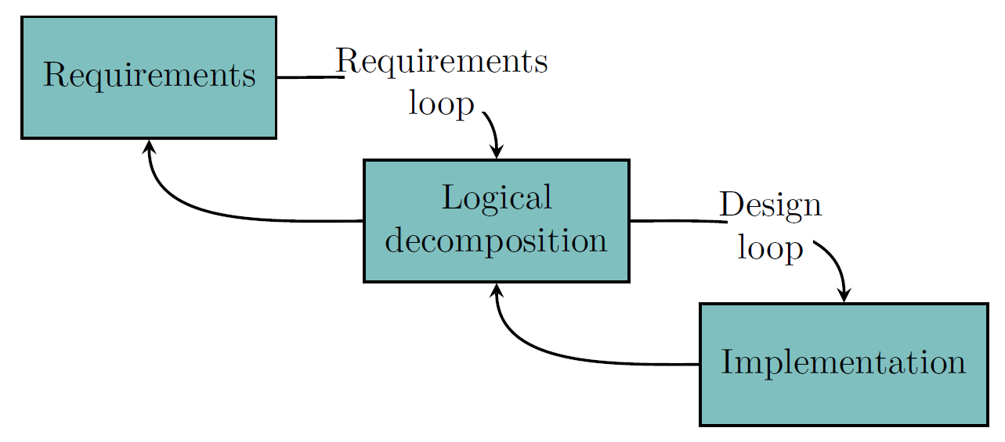
The design process
Design
Notes:
The design process in Systems Engineering is iterative, and the product is improved in each iteration.
In the Requirements loop, it is defined what the system must do (requirements) and the elements needed to perform all those functions (logical decomposition)
In the Design loop, the system is designed and built according to the architectures defined in the Logical decomposition step, identifying issues and propagating back if needed

Slide 14
Requirements
Design
A statement or characteristic of something that is needed.
Notes:
A requirement is a statement or characteristic of something that is needed.
For the case of the OCAS, they represent the set of features and objectives that the system must accomplish to meet the final goal of the OCAS: Avoid collisions against Obstacles
The requirements document is accessible to the whole design team and should be constantly updated (live or evolving document)
In Systems Engineering requirements drive design

Slide 15
Requirements
Come from:
Customer needs → Motivation
Regulations
Defined goals and objectives
Assumptions and constraints
Design
Notes:
The requirements (what the system must do) can come from:
Motivation instead of customer needs because there is no customer

Slide 16
Requirements
The OCAS shall:
Improve the operational safety of the UAV
Avoid collisions with the detected obstacles
Work independently of the UAV
Not interfere with existing UAV functions
Be accessible from the GCS
Be operable after a short training by any pilot
Design
Notes:
Example of most significant requirements.
“Avoid collisions” can be thought as derived from the “Improve operational safety” requirement
Work independently -> To enhance modularity and upgradeability
Not interfere -> Change behaviour of the UAV only when there is risk of collision
GCS = Ground Control Station

Slide 17
Logical decomposition
Design
Decomposes the requirements
Helps build a system architecture
Notes:
Decomposes the requirements and helps build a system architecture by identifying the functions that must be performed
Also called Functional analysis

Slide 18
Logical decomposition
Tools
Design
Functional architecture
FFBD
PBS
N² diagram
Notes:
There are many tools for the logical decomposition of the system
Functional architecture: Hierarchical representation of all the functions
FFBD: Sequential order of the functions during a mission
PBS: Set of elements that need to be included in the system to perform all the identified functions
N2: Interfaces between the elements identified in the PBS

Slide 19
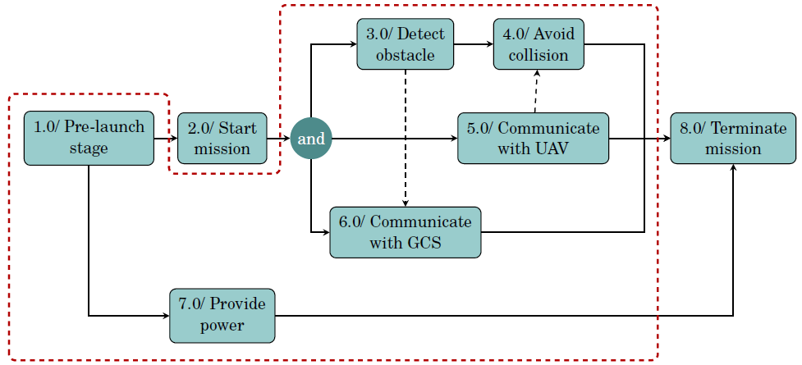
Functional Flow Block Diagram
Design
Notes:
FFBD represents the sequential order of execution of the defined functions to complete a successful misión
Inside dashed red line are the functions performed by the OCAS (scope)
This is the top level of functions, each one is composed by several subfunctions

Slide 20
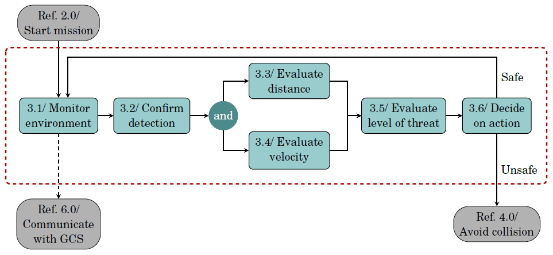
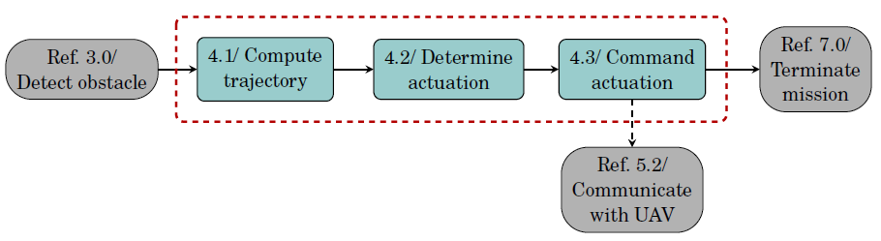
Functional Flow Block Diagram
Design
Notes:
Most critical functions are “detect” and “avoid”
Monitor environment function is working in an endless loop
When the situation is considered as unsafe, the avoid function gets triggered
Skip over functional architecture

Slide 21
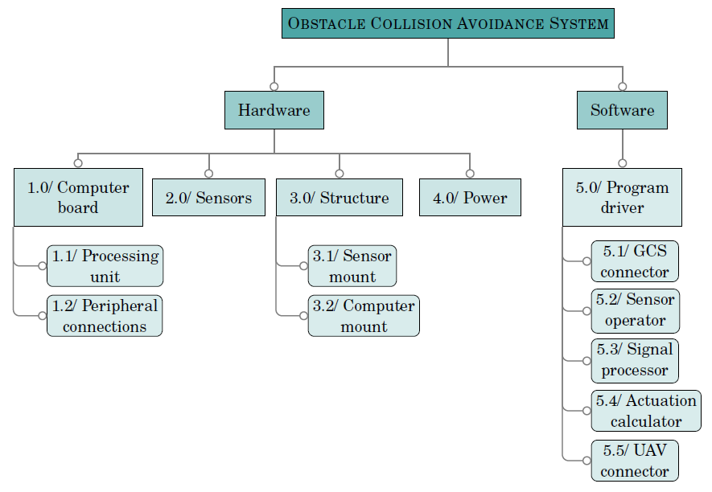
Product Breakdown Structure
Design
Notes:
PBS represents the system physical architecture, derived from the functional architecture
Most important elements for the OCAS are the Computer board and the Software

Slide 22
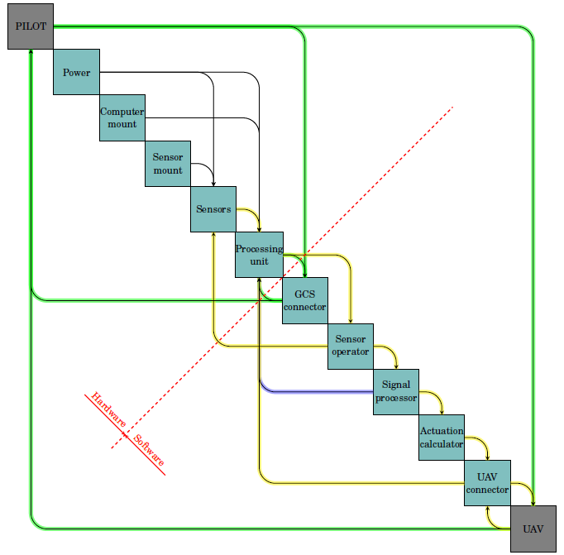
N² diagram
Design
Notes:
Most important elements from the PBS in the diagonal
Outputs from each of the elements in their horizontal rows
Inputs to each element in the vertical columns
Green paths: UAS without OCAS
Yellow paths: Classic control problema
Blue path: Logging information
Black paths: Pysical interfaces
EXAMPLE: Start in processing unit -> end in avoidance manoeuvre by UAV

Slide 23
Implementation
Notes:
After the Requirements, Funcional architecture, FFBD, PBS and N2 diagram, we have a comprehensive idea of WHAT the system must do and HOW it must do it, together with the communications that need to be established.
Now it is time to implement all these concepts from the conceptual design into an actual product, which is able to meet the specifications

Slide 24
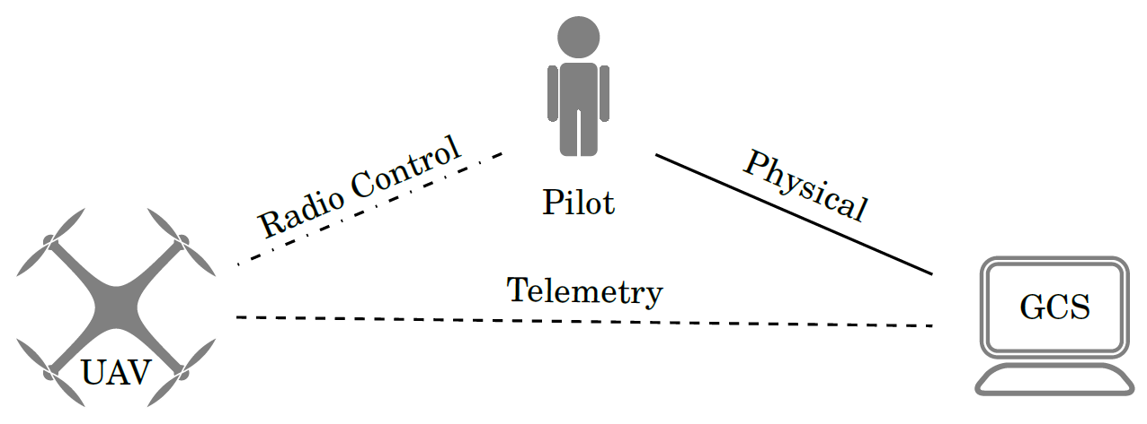
Integration with the UAS
Implementation
Notes:
UAS = Unmanned Aerial System. Contains (one or more) UAVs, GCS and any other element relevant for the operation of the UAV

Slide 25
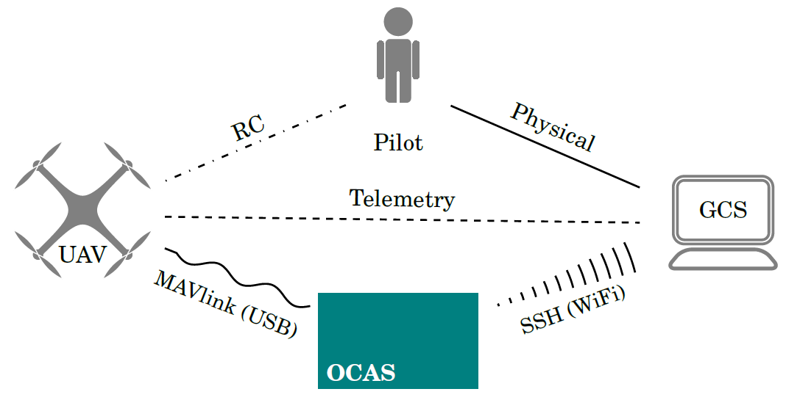
Integration with the UAS
Implementation
Notes:
OCAS will be embarked on the UAV, holding a second wireless connection with the GCS

Slide 26
Component choice
Sensors
Alternatives:
Radar
Sonar
Lidar
Computer vision
Evaluation criteria:
Range
Accuracy
Flexibility
Weight
Cost
Ease of operation
Ease of integration
Implementation
Notes:
Trade-off study between all the possible alternatives, evaluating each of them on all of the criteria
More detail in the paper

Slide 27
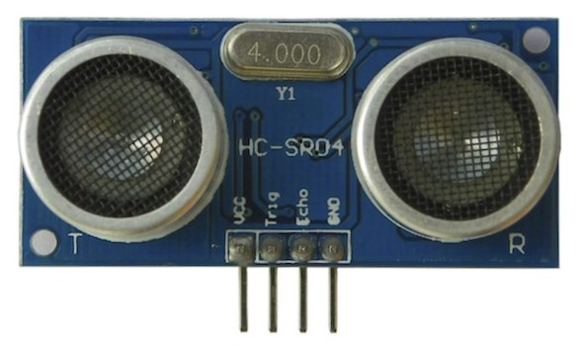
Component choice
Sonar HC-SR04
Implementation
Notes:
Advantages: Light weight, low cost, simple operation (trigger-echo), easy processing (multiply time by speed of sound -> distance to closest object)
Disadvantages: Noisy environments, ghost signals and multipath errors

Slide 28
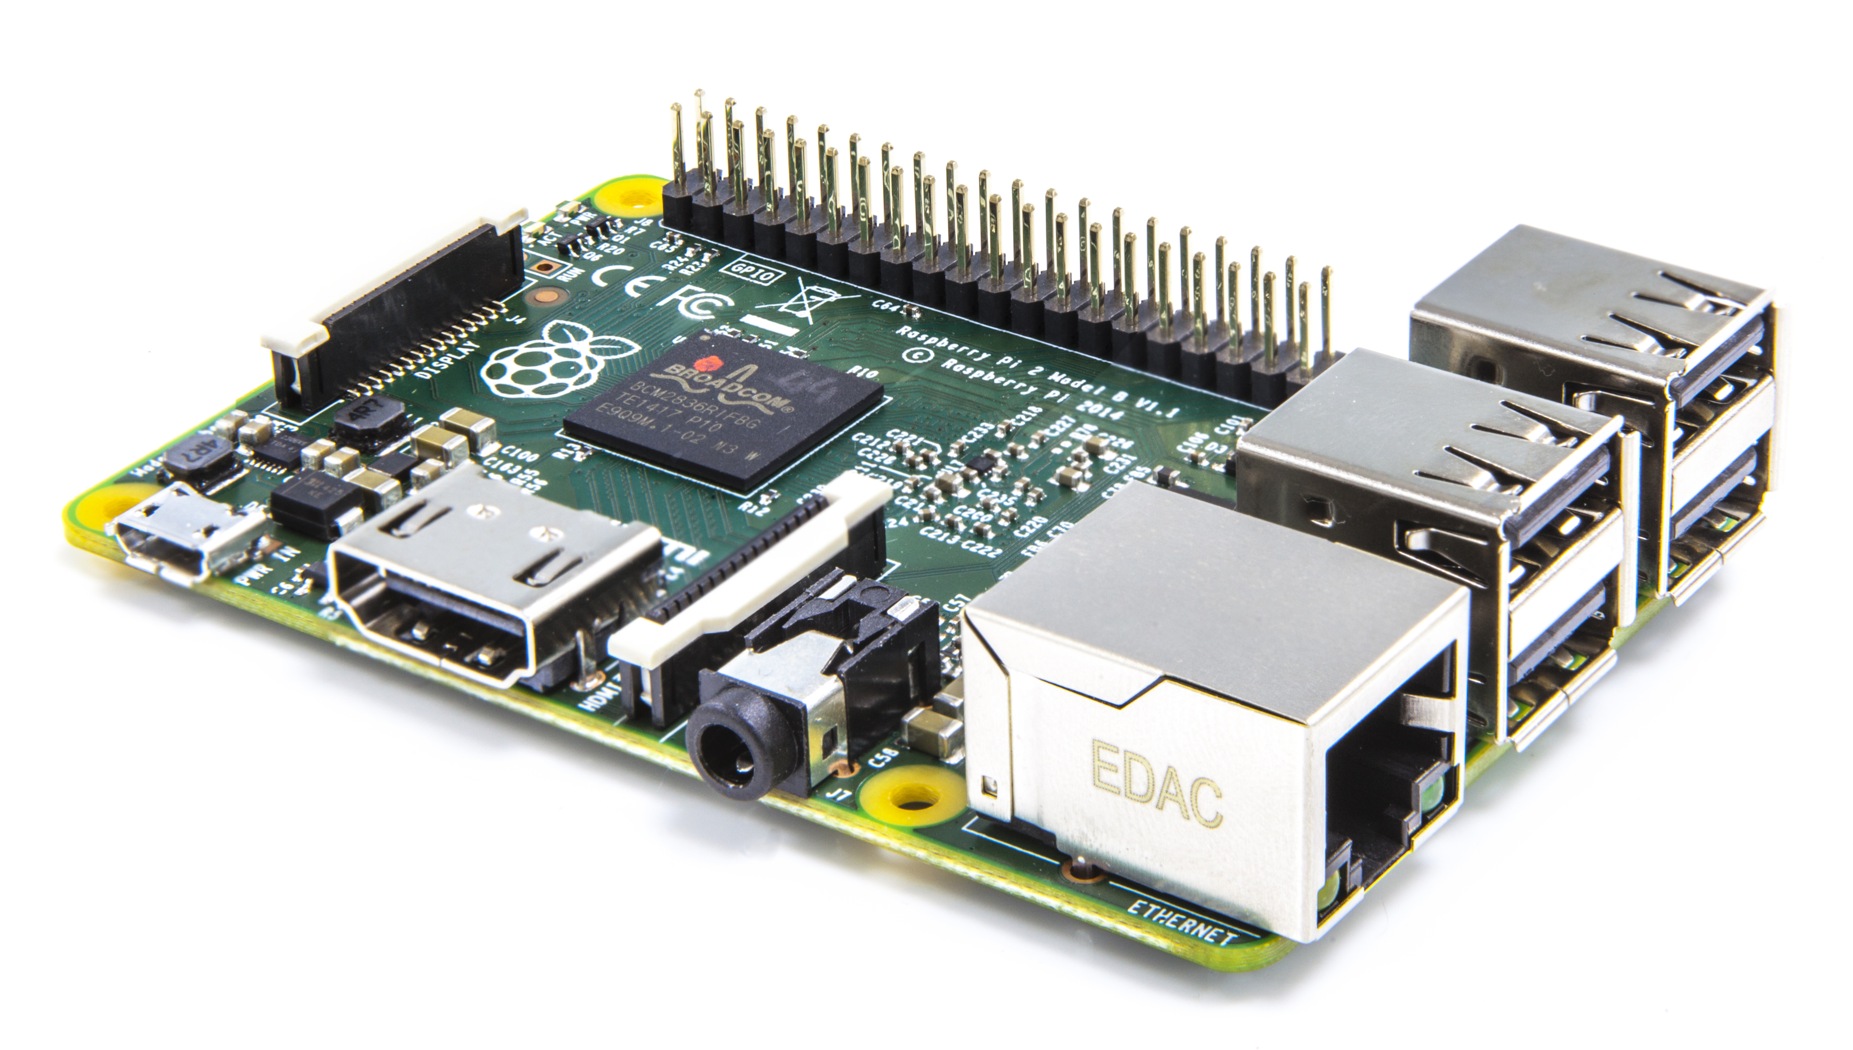
Component choice
Raspberry Pi
Full computer
Credit card size
Linux OS
GPIO pins
4x USB ports
Networking capable
Implementation
Notes:
Alternative: Microcontroller board (Arduino). Less computationally capable, no Operating System, no networking… -> more limited

Slide 29
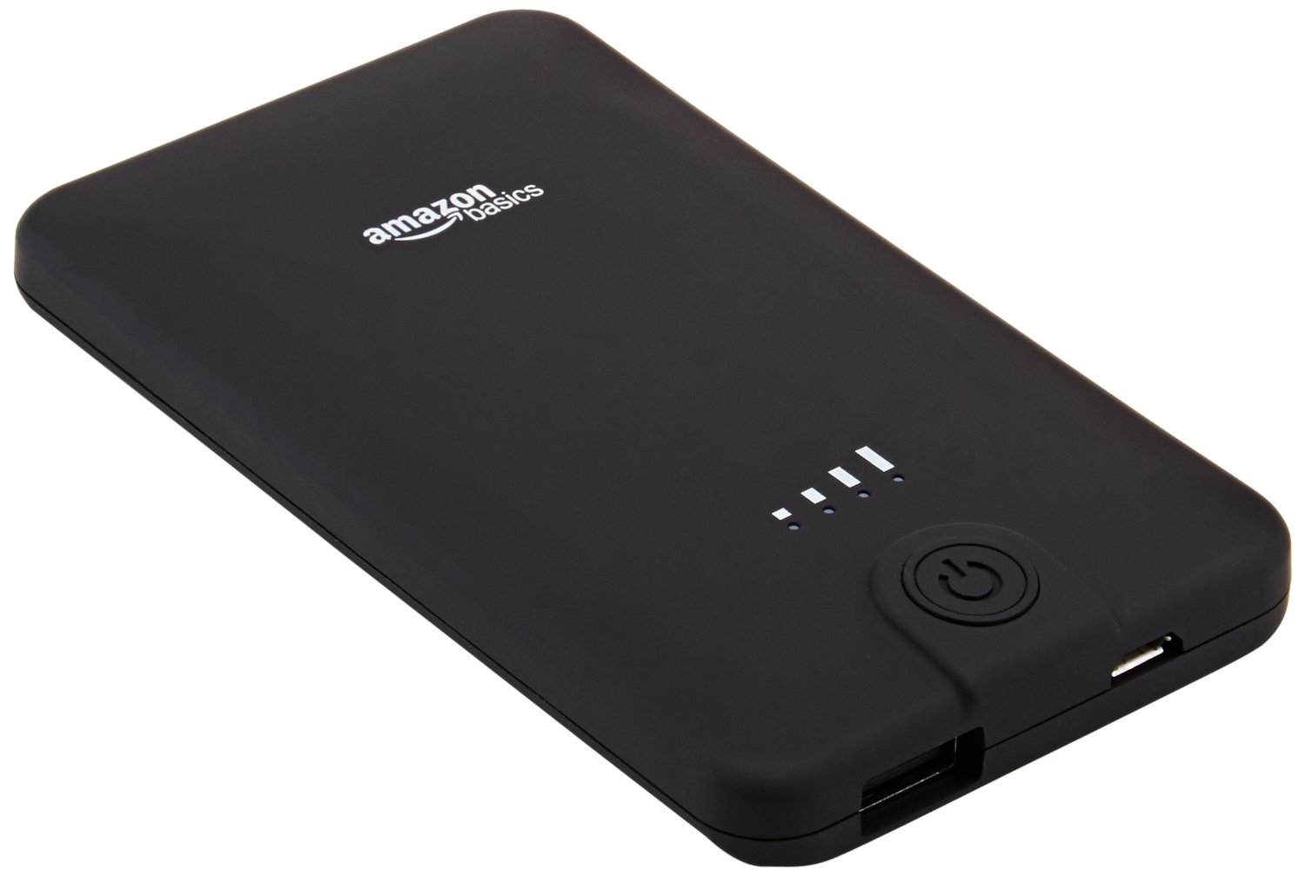
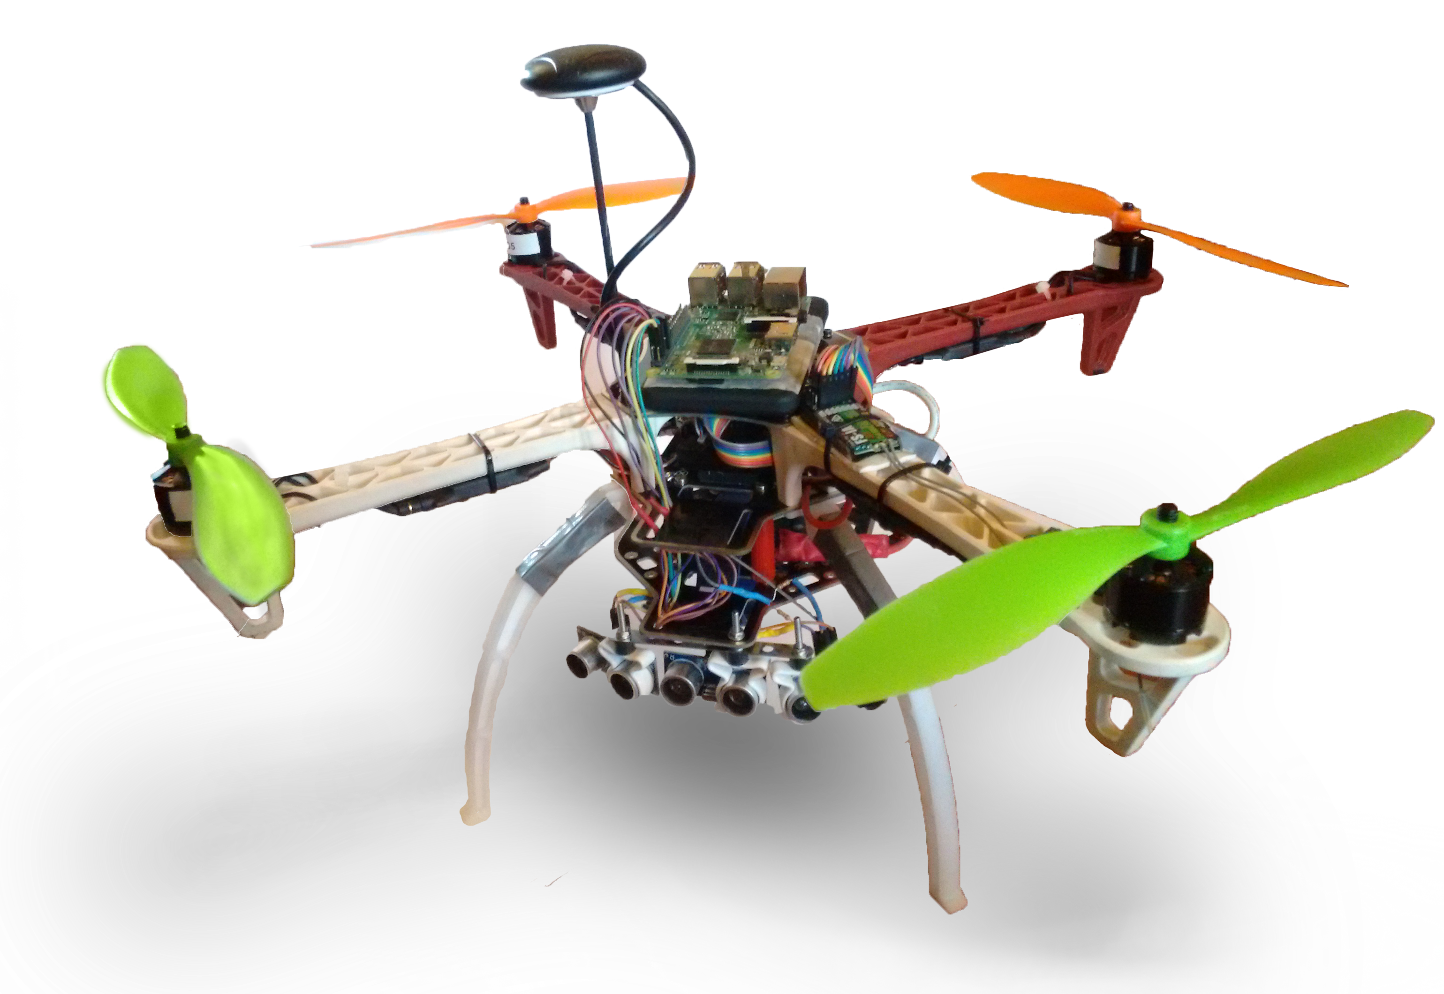
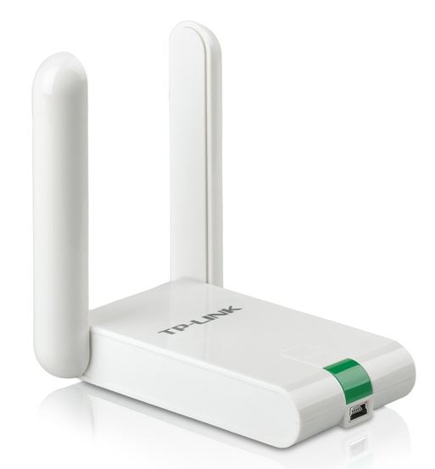
Other components
Implementation
Power source
Testing platform
WiFi adapter
Notes:
Battery according to the requierement of independency with the UAV. Provides 2.4 A to the Raspberry Pi
WiFi adapter for the wireless communication with the GCS, as shown before
Testing platform based on Maite Arteta’s Thesis from 2015

Slide 30
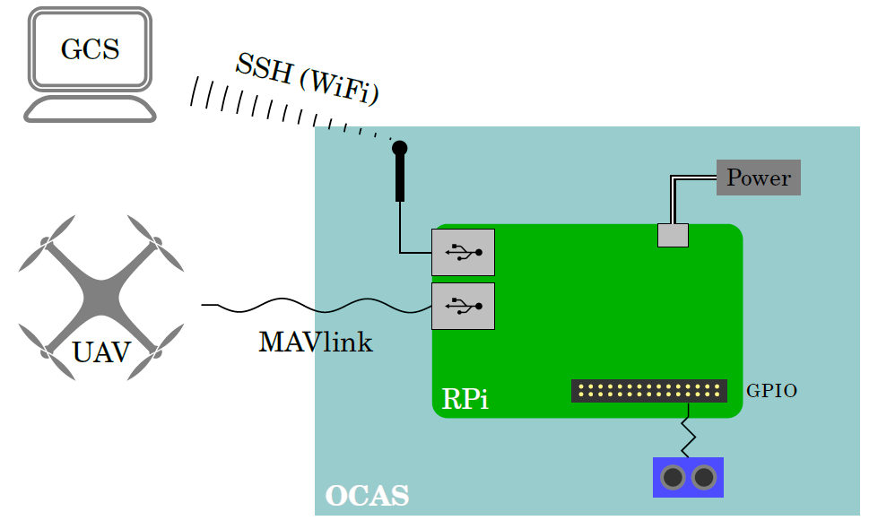
OCAS interfaces
Implementation
Notes:
Everything considered part of the OCAS is enclosed in the blue box
The Raspberry Pi is the main controller, where all the other elements are connected
SSH: allows for the remote access to the Linux terminal from the GCS
MAVlink: is the comunication protocol for all Ardupilot UAVs. Both low and high level commands (examples)
GPIO: Regular wires. State of the pins can be set LOW or HIGH (that is, 0V or 3.3V) via software

Slide 31
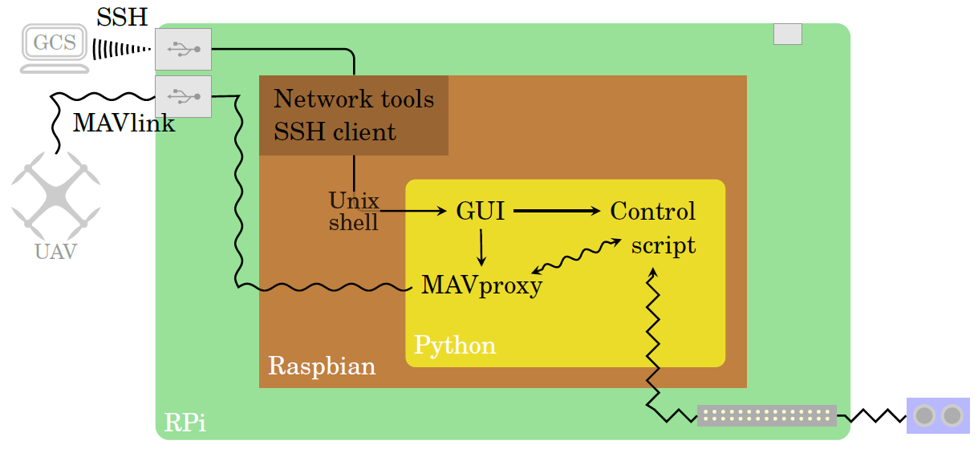
Software interfaces
Implementation
Notes:
Schematic derived from the N2 diagram
Inside the Raspberry Pi, Raspbian OS provides some utilities that allow for easy connection of the external components
Also, it can run a Python environment, under which all the other functions have been developed
First, from the SSH interface, the operator has access to the Linux Shell, from which the Graphical User Interface can be launched
From the GUI, MAVproxy and the Control script can be launched with the appropriate parameters
MAVproxy connects to the vehicle via one of the USB ports and pipes the MAVlink messages to the Control script
The script takes that information, together with the one retrieved from the sonar, and processes it in the way that was shown in the FFBD (more information later)
Finally, if an actuation is required, a MAVlink message is sent back to the UAV through the MAVproxy software

Slide 32
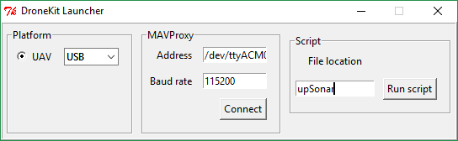
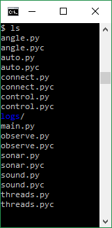
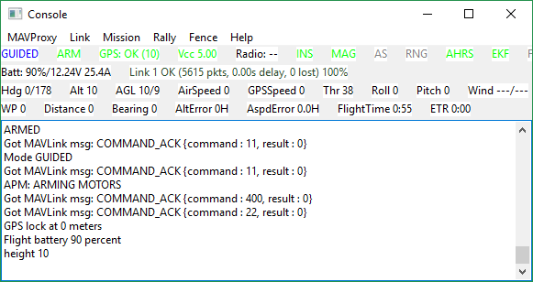
The Python environment
Implementation
GUI
Control script
MAVproxy
Notes:
GUI: Select connection method, and connection fields autocomplete with the default settings.
Connect button launches MAVproxy with the specified settings and pipes the information to the script
GUI: Write the name of the folder where the main.py file of the script is located, and run it
The script is composed of several Python files, which I’ll try to give an overview of.

Slide 33
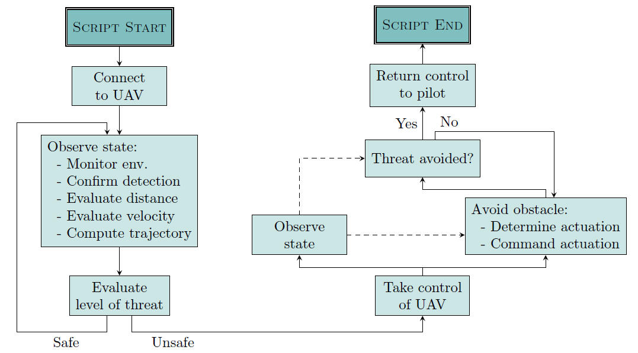
The Python script
Implementation
Notes:
According to the PBS, any component of the system that has not been covered yet needs to be implemented in the Python script
Flowchart of functions, following the FFBD. EXPLAIN
Dashed lines represent information flow, not sequential order

Slide 34
The Python script
Implementation
Notes:
Consider these specific functions for a deeper analysis

Slide 35
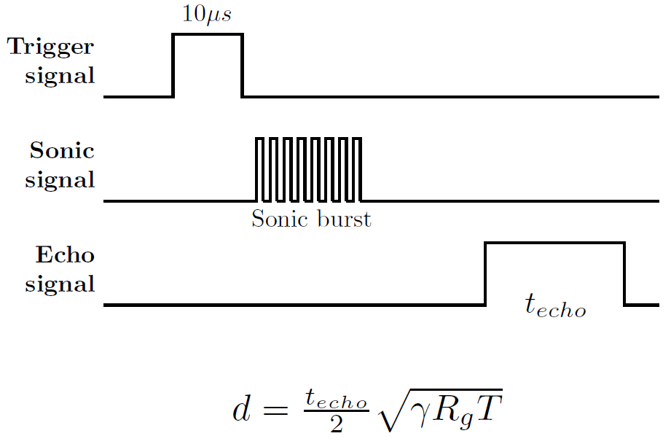
Evaluate distance
Implementation
Notes:
With a 10us signal on the trigger pin of the sonar, it automatically sends a sequence of ultrasonic signals
It recieves those signals if rebounded against an obstacle and calculates the time of arrival
An ouput signal of the same lenght in time is returned through the echo pin
Notice the dependency of the measured distance on the environmental temperature.
However, a temperature difference of 10ºC w.r.t the reference induces errors of the order of 1mm, so negligible

Slide 36
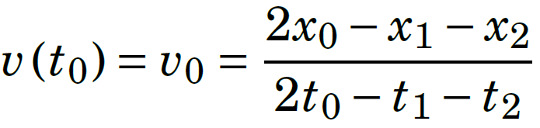
Compute velocity
First order backward differences with a two-data-point stencil
Implementation
Notes:
Why? Because the signal is noisy, and differentiating a noisy signal amplifyes the noise (the differentiation is a perfect high-pass filter)
This approach has better damping properties than conventional differentiation, so that better predictions of position can be made

Slide 37
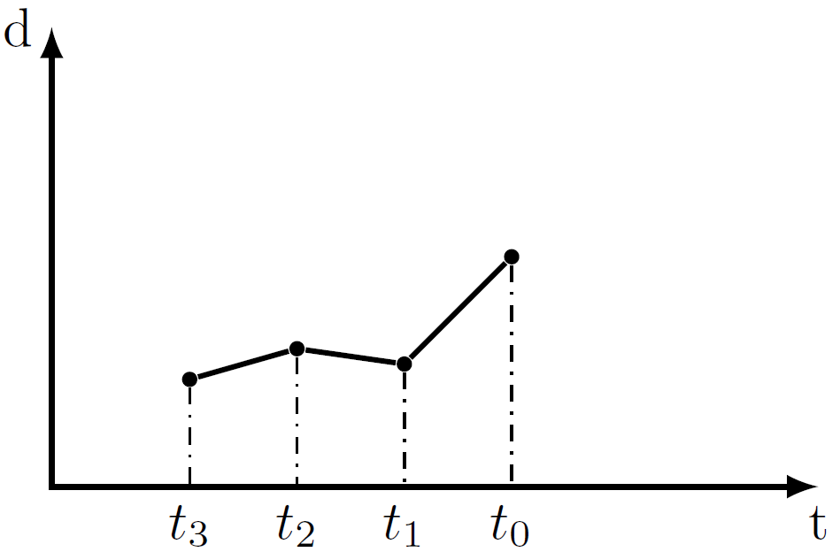
Compute velocity
First order backward differences with a two-data-point stencil
Implementation
Notes:
EXAMPLE
Imagine that the last measurement (t0) is not correct for some reason

Slide 38
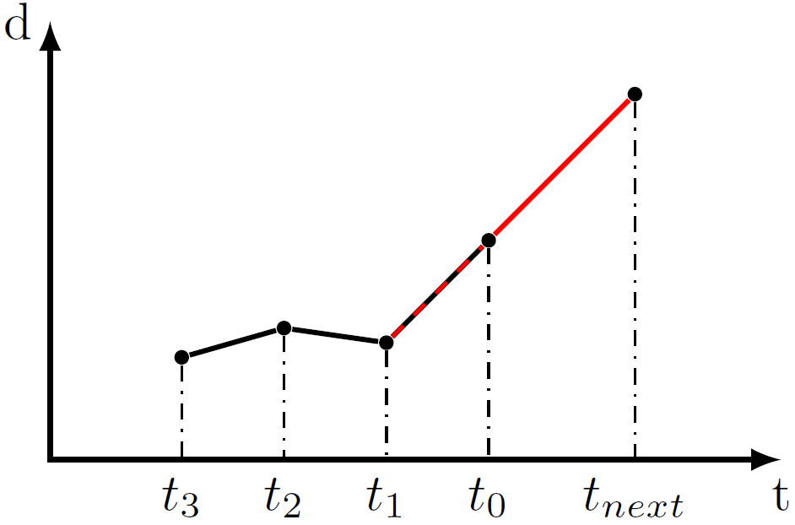
Compute velocity
First order backward differences with a two-data-point stencil
Implementation
Notes:
Computing the slope of the last interval and propagating into the future yields to an even bigger error

Slide 39
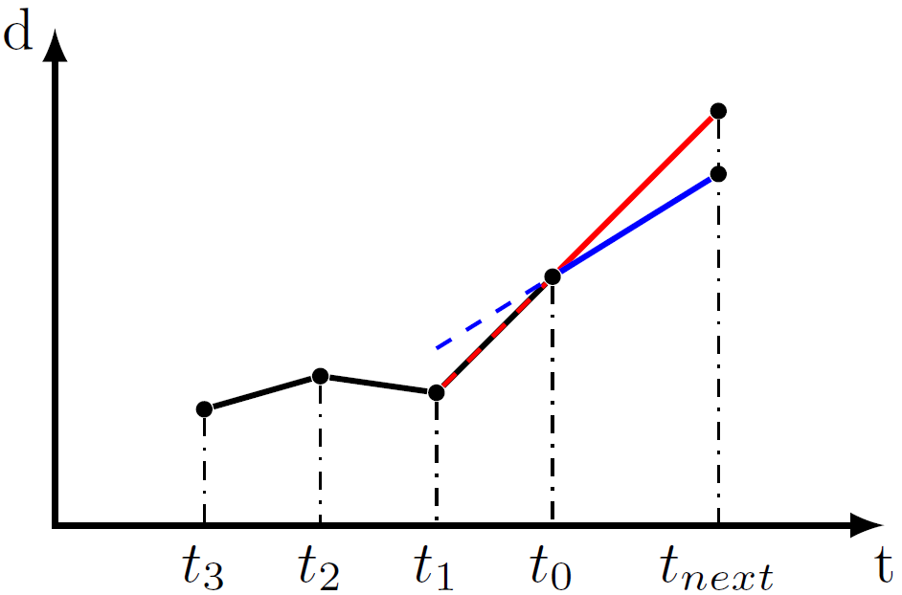
Compute velocity
First order backward differences with a two-data-point stencil
Implementation
Notes:
Instead, with the two-data-point stencil, the error is dampened, while maintaining relatively responsive predicting capabilities on the future location of the obstacle

Slide 40
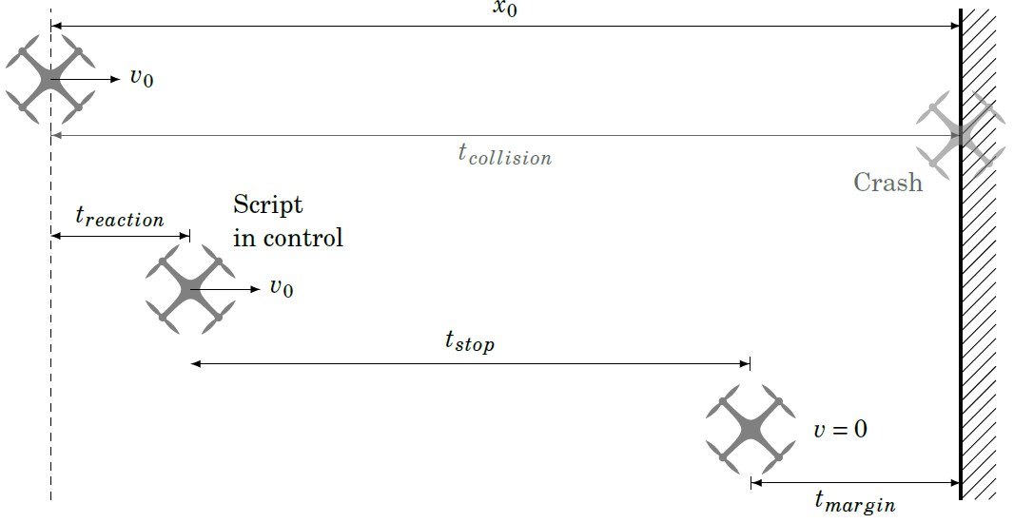

Evaluate level of threat
Implementation
Notes:
Assuming any instant of time when the distance to the detected obstace is x0 and the velocity is v0, a linear extrapolation can be done to predict the time remaining to the collision.
Now, considering the reaction time of the script to take control of the vehicle, the estimated time to stop the UAV at the current speed and some margin for errors, I claim that the scenario is unsafe when tsafe, defined as shown below, is smaller than 0.
That is, the UAV has less time to stop and prevent the collision than the available time to the collision itself.
Hence, the avoidance manouvre will be triggered when tsafe<0

Slide 41
Avoid obstacle
At the moment:
Guided mode (loiter)
“Go to” functions based on GPS data
Implementation
In the future:
Real time control
Fused data from sonars + onboard sensors
Notes:
This stage only developed as a proof of concept. Functional enough to avoid a collision
Great chance of improvement, with sophisticated signal processing techniques
Concepts of navigation and trajectory planning could be incorporated

Slide 42
Testing

Slide 43
Testing

Slide 44
Testing

Slide 45
Conclusions

Slide 46
Conclusions

Slide 47
Conclusions

